Slide 1

Build a Conversational AI Tutor

Slide 2


ABOUT ME
Name : Singireddy Pravalika
Qualification : MSC
Any work experience : Fresher
I want to learn data science for skills and to get a job in scientist field.
It has great job opportunities.
Linkedin Profile URL: https://www.linkedin.com/in/singireddypravalika
GithubProfileURL: https://github.com/SingireddyPravalika

Slide 3
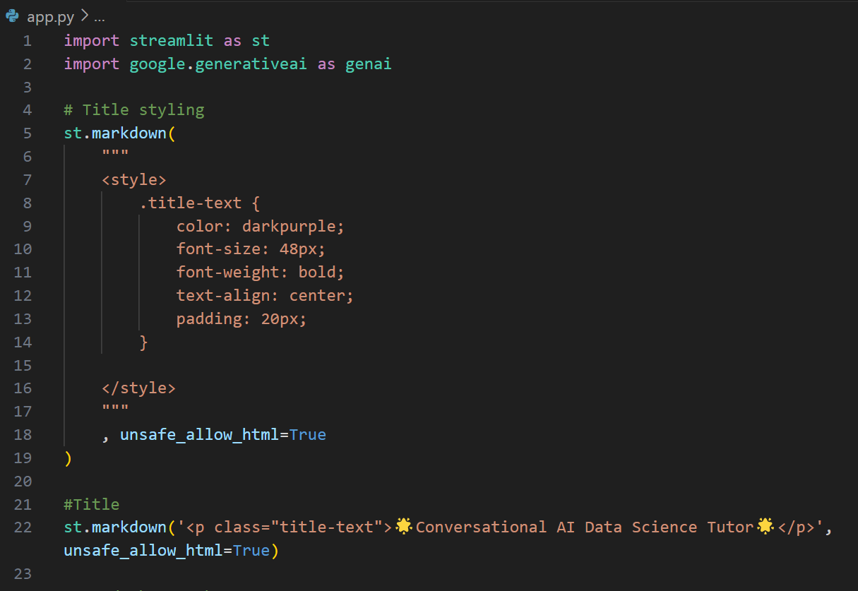


Slide 4
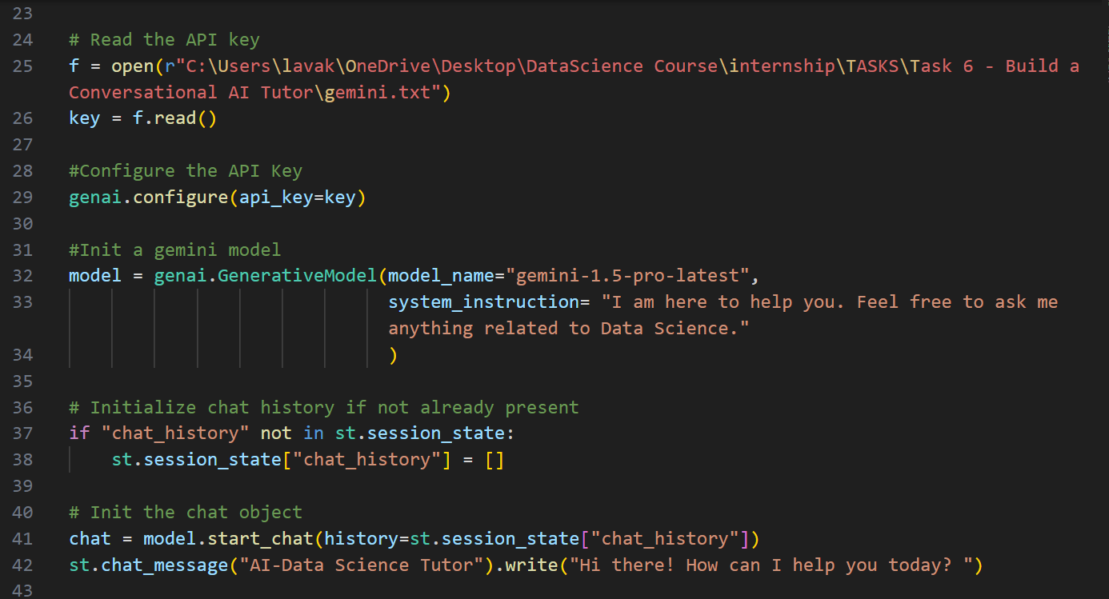

Slide 5
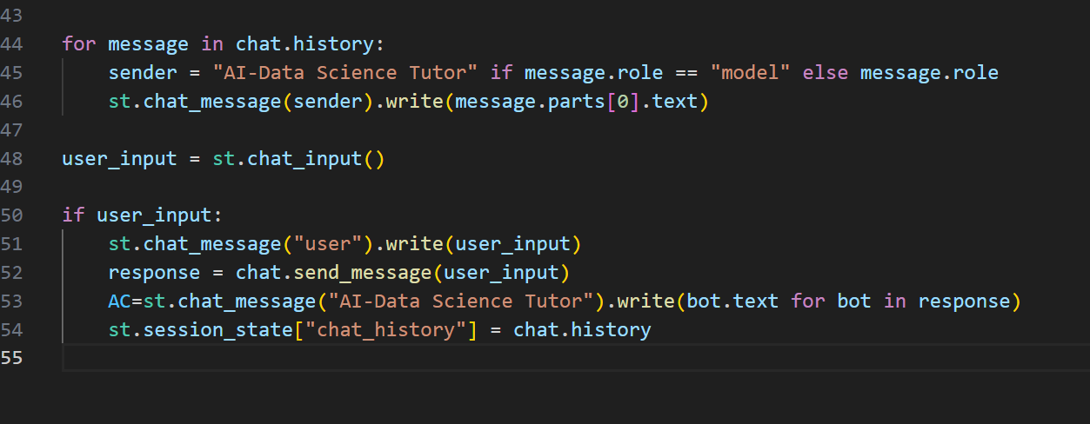

Slide 6
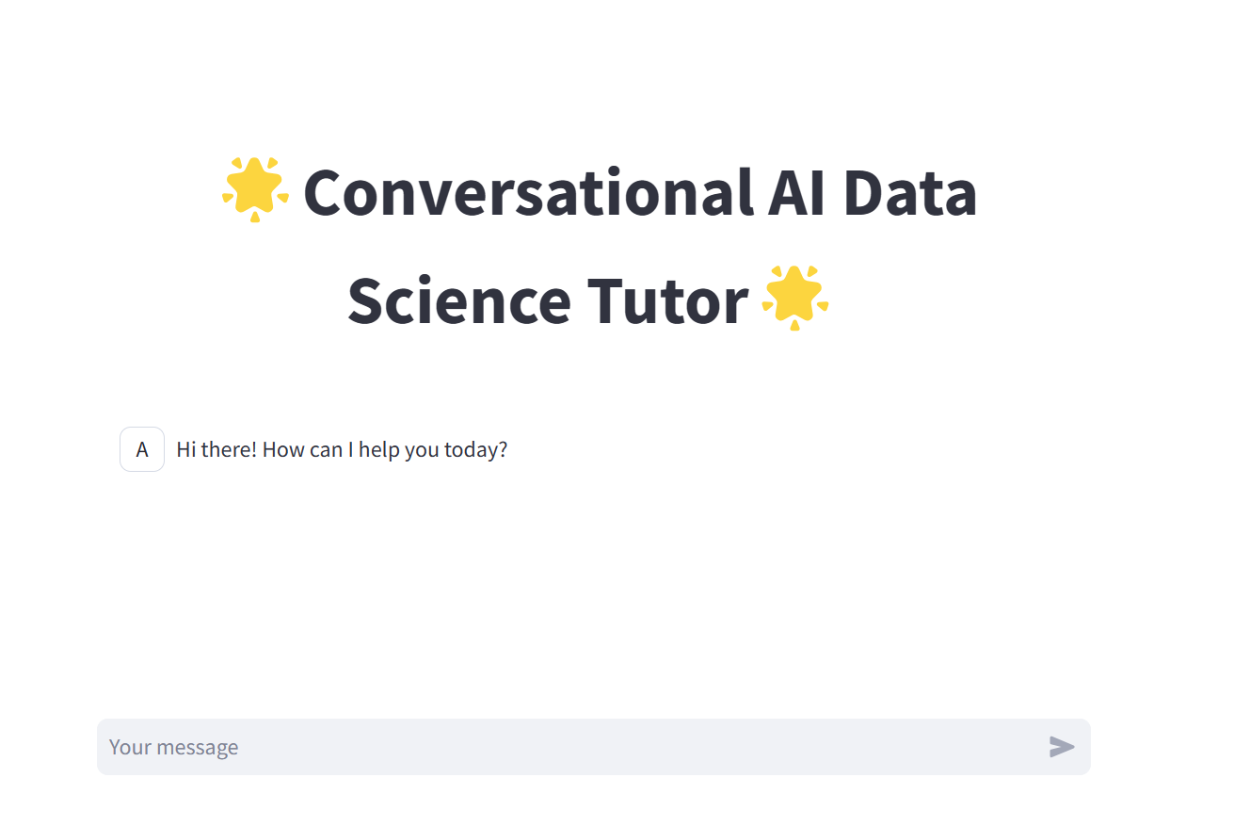

Slide 7
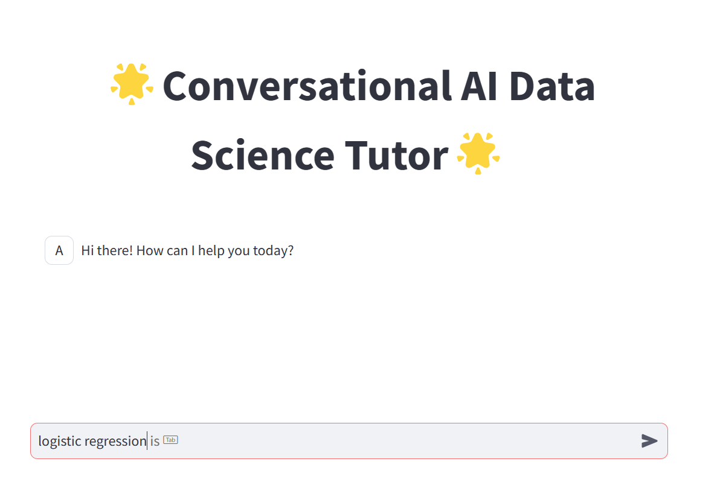

Slide 8
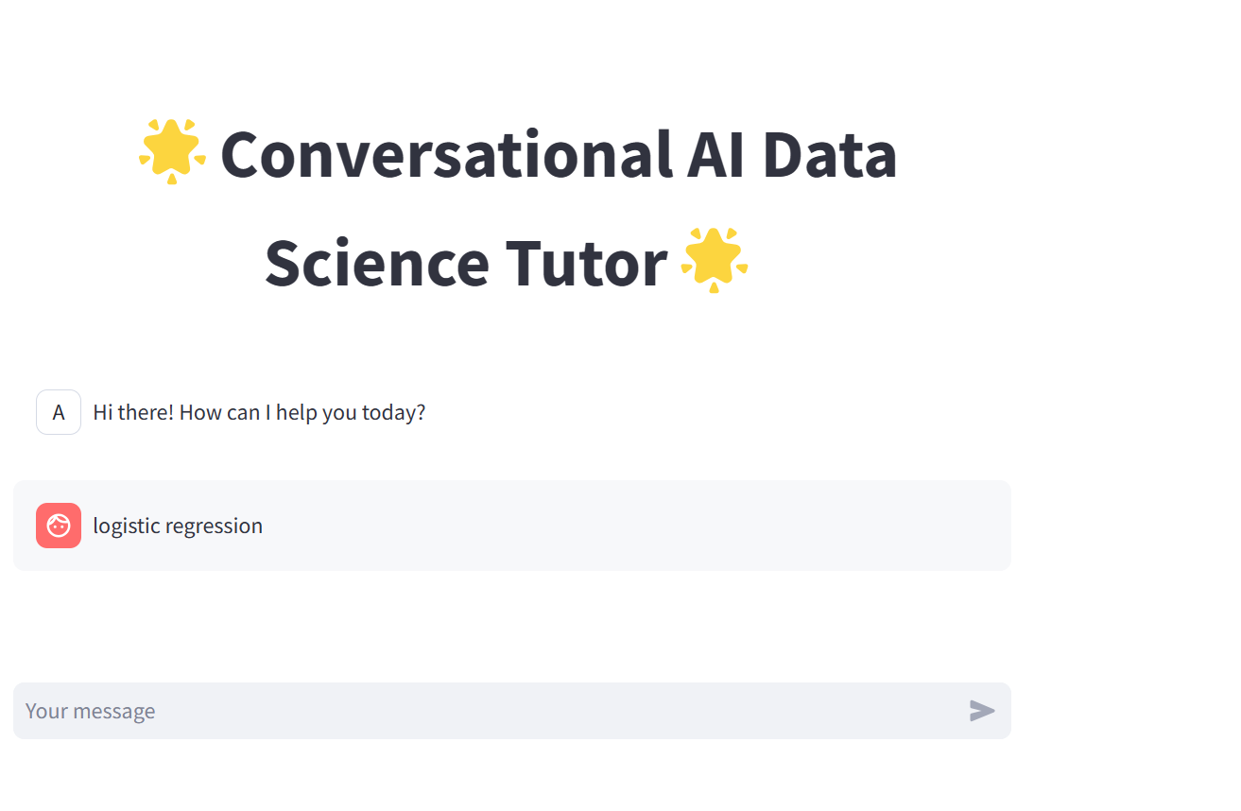

Slide 9
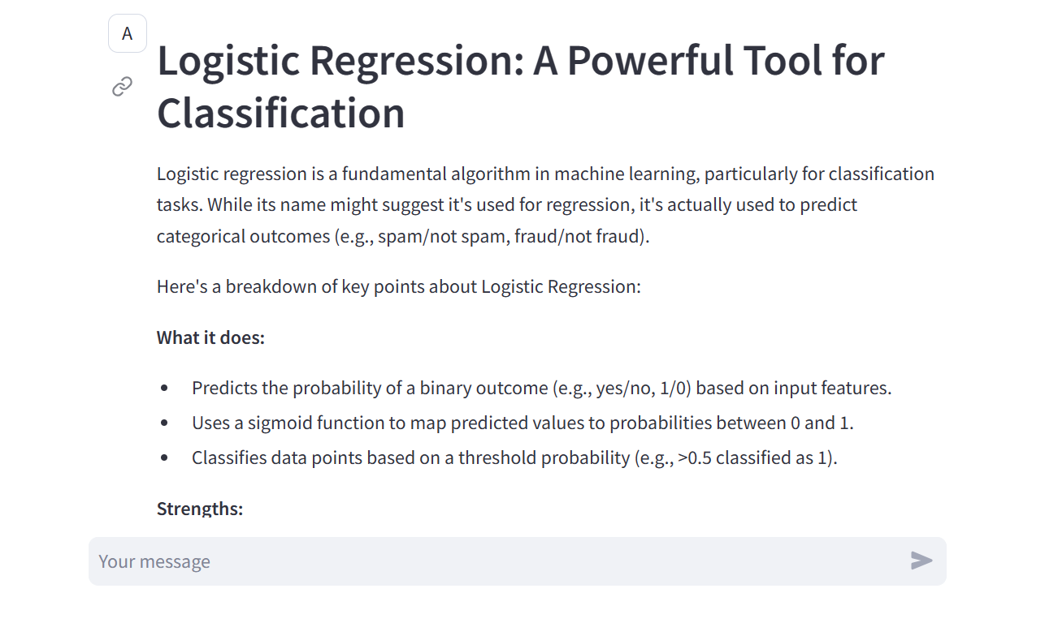

Slide 10


